Slide 1
Numerical Method ICE2142
Mursheda Nusrat Della
Lecturer
Dept. of ICE
BAUET
Lab 2

Slide 2
Read all the pages for understanding false position method and memorize only the equation at the last page for solving mathematical problem.

Slide 3
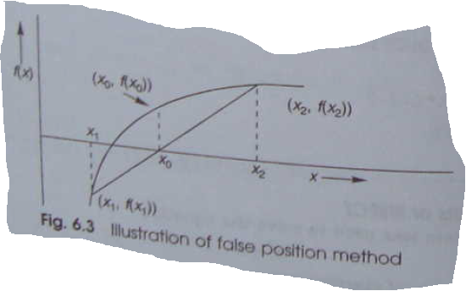
False position method
This is also called linear interpolation method

Slide 4
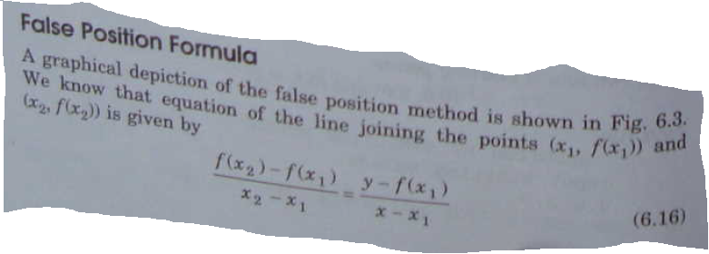
From the fig 6.3

Slide 5
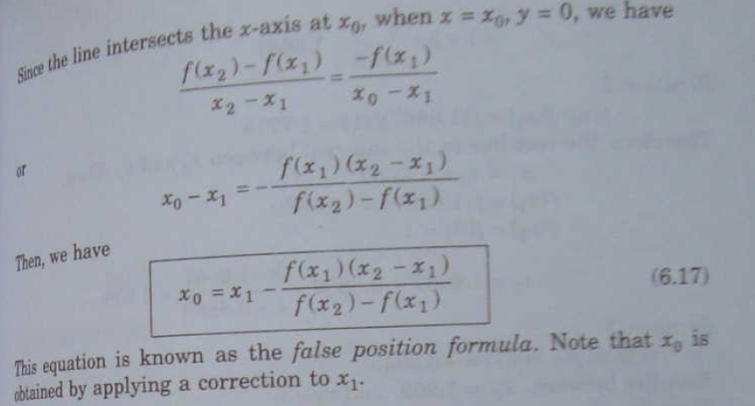

Slide 6
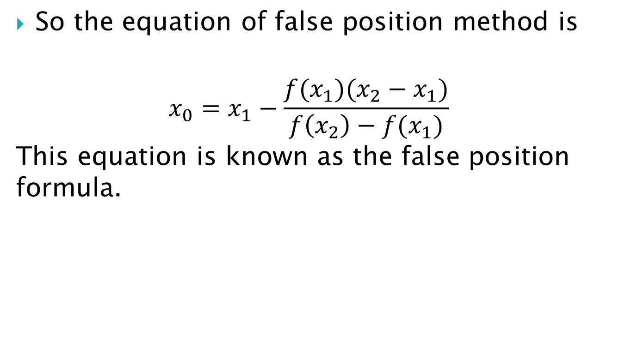
So the equation of false position method is
$$x_{0}=x_{1}−\frac{f(x_{1})(x_{2}−x_{1})}{f\left(x_{2}\right)−f(x_{1})}$$
This equation is known as the false position formula.

Slide 7
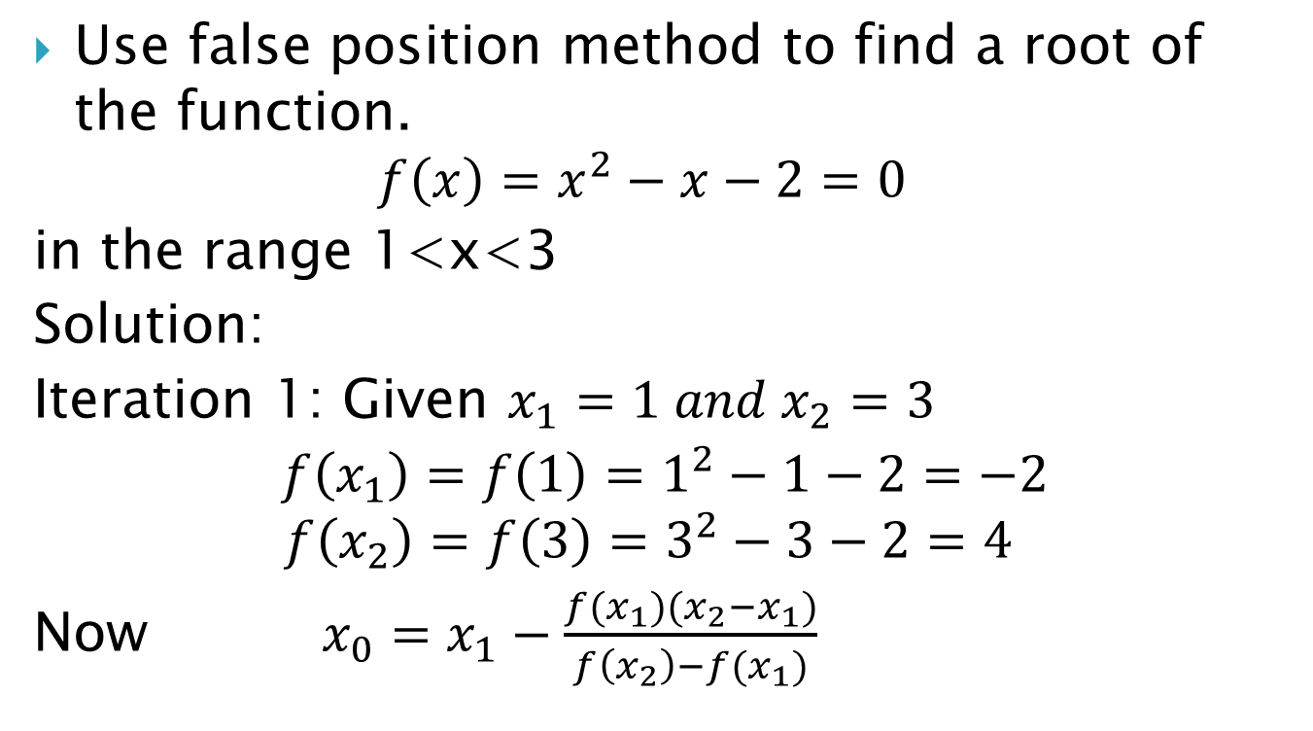
Example 6.5
Use false position method to find a root of the function.
$$f\left(x\right)=x^{2}−x−2=0$$
in the range 1<x<3
Solution:
Iteration 1: Given $x_{1}=1 and x_{2}=3$
$f\left(x_{1}\right)=f\left(1\right)=1^{2}−1−2=−2$
$$f\left(x_{2}\right)=f\left(3\right)=3^{2}−3−2=4$$
Now $x_{0}=x_{1}−\frac{f(x_{1})(x_{2}−x_{1})}{f\left(x_{2}\right)−f(x_{1})}$

Slide 8
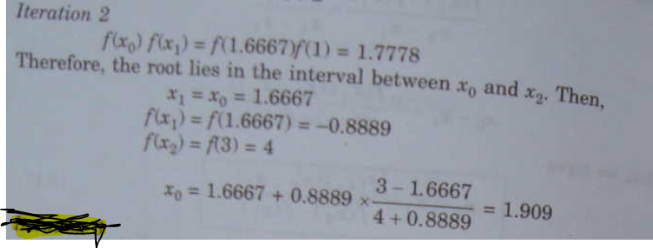

=$1+\frac{2(3−1)}{4+2}$
= 1.6667

Slide 9
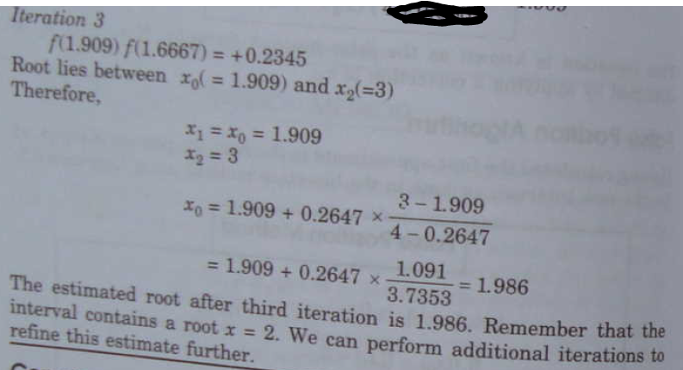

Slide 10
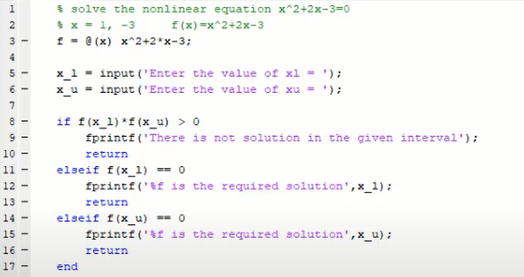

Slide 11
